Slide 1

March Madness
Trent Adamson, Luke Stevens, Jack Dorner

Slide 2

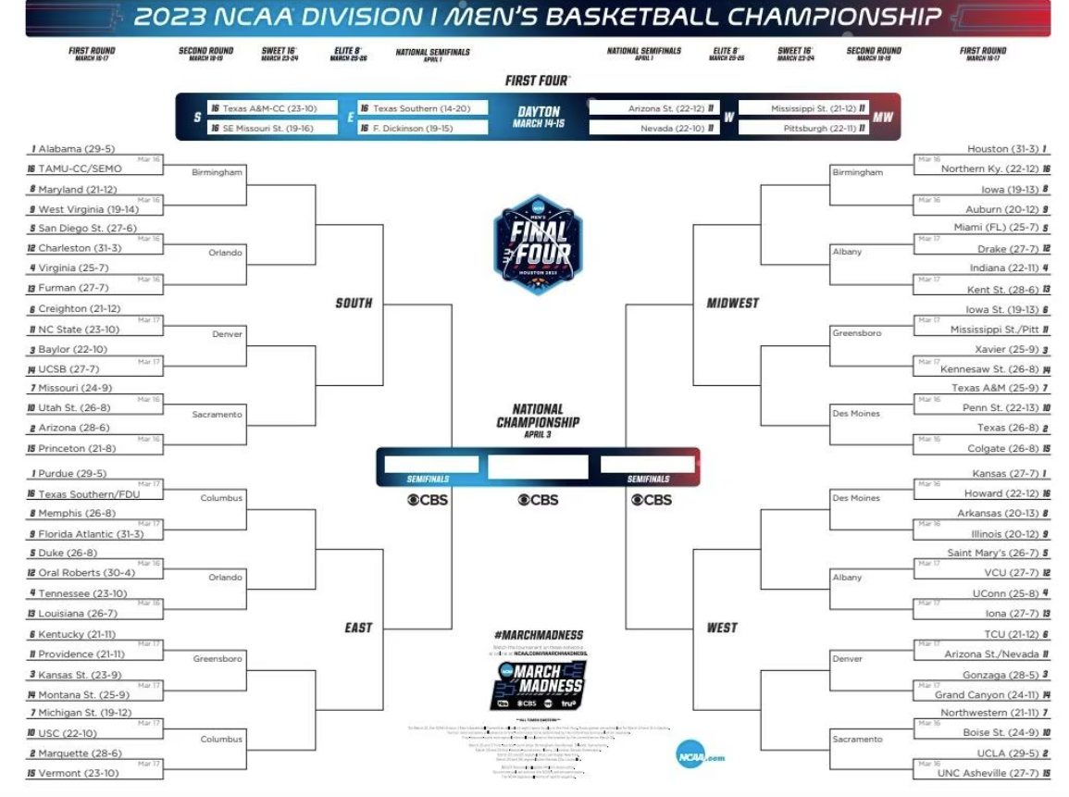


March Madness
Annual NCAA Men’s Basketball National Championship Tournament
68 team brackets
Win or go home
Bracket Games/Tournament Challenge

Slide 3
Research Question:
Can team statistics and past tournament results more accurately predict tournament outcomes than just choosing the better seed each round?

Slide 4
Hypothesis
Null Hypothesis:
A model trained on team statistics and past tournament results will not perform better than choosing the better seed in each round.
Alternative Hypothesis
A model trained on team statistics and past tournament results will perform better than choosing the better seed each round.

Slide 5
Data
From Kaggle:
https://www.kaggle.com/datasets/nishaanamin/march-madness-data/data
2008-2025 (no 2020)
34 different csv files provided
Only used 10 of these CSV's were used in this analysis
To understand what each variable is you have to go to the websites linked in the kaggle dataset. (Note there are hundreds)

Slide 6
CSV files used
Resumes
Shooting Splits
TeamRankings Away
TeamRankings Home
TeamRankings Neutral
KenPom Barttorvik
Barttorvik Away
Barttorvik Home
Barttorvik Neutral
Tournament Matchups (To create the dependent variable)

Slide 7
Data Analysis

Slide 8
Data preparation and preprocessing

Slide 9
Experimental design

Slide 10
Modeling

Slide 11
Results

Slide 12
Discussion and analysis

